Slide 1

Status 200 Allianz insurance
New graduate program 2020
Project: Travel Insurance
Notes:
Good Morning Everyone. I am ……… from Status 200 team.

Slide 2
Agenda
01 | Member Introduction | 04 | demo
02 | Business requirements | 05 | Problem & solution
03 | Development process | 06 | Q&A

Slide 3
Team name: Status-200
Front End Developer
Anthika Jirattananon (Mint)
Donlaporn Chantarat (Nam)
Pamuta Keawjit (Frong)
Smarch Poonkwan (Khan)
Back End Developer
Araya Siriadun (Aim)
Krittinon Phruekakkharakun (Year)
Quality Assurance
Tidanat Kumpuak (Fah)
Natnapa Raktavee (Pim)

Slide 4
02
Business
requirement

Slide 5



Project Requirement
Product should be ….
Display on Web Application Less than 4 Pages Blue Style base on company logo

Slide 6

Project introduction
Departure Date | Return Date | Travel Days
01/08/2020 | 01/08/2020 | 1
01/08/2020 | 02/08/2020 | 2
… | … | …
01/08/2020 | 27/08/2020 | 180
Duration (day) | Insurance Premium / Person
1-4 | 235 THB
5-6 | 357 THB
… | …
91-180 | 1,953 THB
Travel Insurance
Travel Days
Insurance Premium

Slide 7
















BUSINESS Process
STATUS-200
21
26
1. User wants to buy insurance
2. User selects country
3. User selects package and read benefits
4. User selects departure date and return date
5. User inputs information
6. User views summery details
7. User reads term condition
8. User view and confirm payment

Slide 8
03
Development process

Slide 9
Development process
STATUS-200
MON
Get Requirements & Design
TUE
Design
WED
Design
THU
Design
FRI
Completed ‘Booking’ page (TS)
Completed ‘Booking’ page (HTML + CSS)

Slide 10
Development process
STATUS-200
MON
Completed ‘Input’ page (HTML + CSS)
Completed ‘Input’ page (TS) (wait for API)
TUE
Completed ‘Display’ page (HTML + CSS)
Completed ‘Display’ page (TS) (wait for API)
WED
Completed ‘Payment’ page (HTML + CSS)
Completed ‘Payment’ page (TS) (wait for API)
THU
Completed all pages with connected API
Presentation preparation
FRI
Presentation

Slide 11



Dairy work
Scrum Meeting
Team Update
Daily
Review
Lunch
09.00 AM 09.15 AM 12.00 PM 13.00 PM 15.00 PM 15.30 PM 16.00 PM

Slide 12

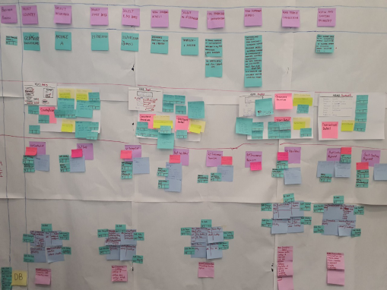

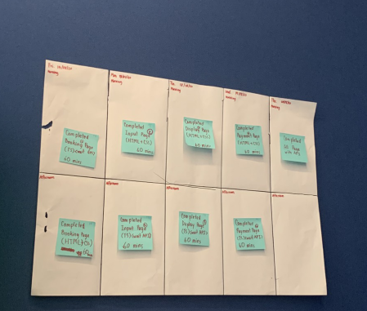



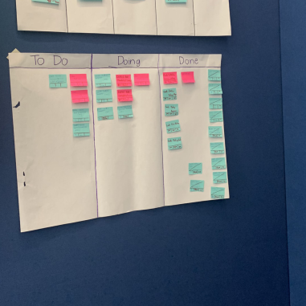


tools
STATUS-200
For Planning
To Do List
Blueprint
Sprint Plan
For Development
Mongo DB
IntelliJi IDEA
Spring Boot
Angular
Bootstrap
Material Angular
For Test
Robot Framework
Postman

Slide 13
05
Demo

Slide 14


Test Scenario 1: A traveller buys travel insurance and success to purchase with Allianz insurance website
21
A traveller
wants to buy a travel insurance package
26
6 days for Switzerland trip
from 21/08/2020 to 26/08/2020

Slide 15

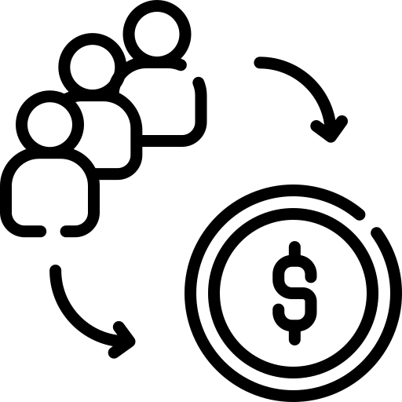



Test Scenario 1: A traveller buys travel insurance and success to purchase with Allianz insurance website (Continue)
User can go to website of ‘Allianz Insurance’ for buy insurance
buy insurance premium 357.00 THB and Payment
Purchase successful

Slide 16
06
Problem & solution
Problem & solution
Problem & solution

Slide 17
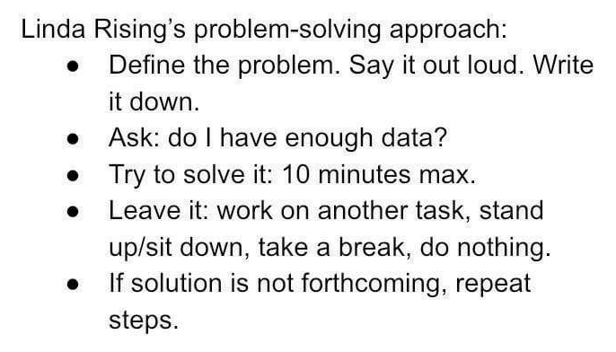
Problem and solution
Problem
Solution
Discussion conflict
Adapt from Linda Rising’s
“
”

Slide 18
Q & a

Slide 19
Thank you

